Slide 1





Instant payments increase ICT risk under DORA
Real-time service
No recovery window
Management accountability applies
Instant payments require explicit, service-specific ICT risk treatment
Governance
Third-party visibility
Time criticality

Slide 2
ICT risk reduction roadmap
Month 0-3
Governance decisions
Month 3-6
Detection thresholds
Month 6-9
Incident playbooks
Dependency mapping
Interim incident escalation
Access controls
Service-specific monitoring
External coordination
Recovery testing

Slide 3
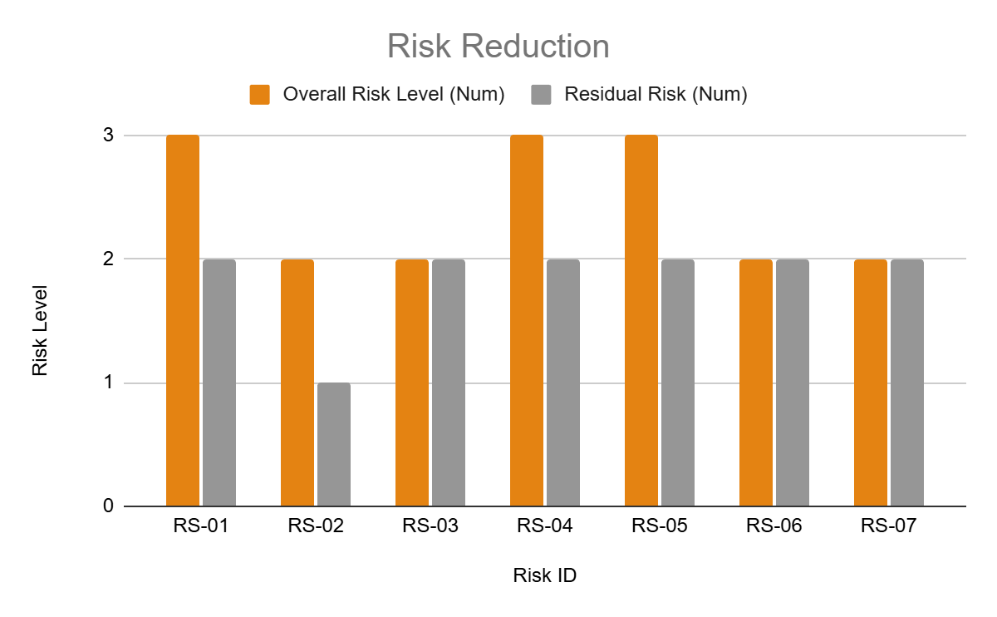
Make management decisions
Recognize instant payments as a critical ICT-supported service
Approve a focused remediation roadmap (≤ 9 months)
Formally accept documented residual ICT risk
DORA-aligned ICT resilience without system redesign

